Slide 1
Neural Networks

Slide 2
Biological Neuron
A human brain has billions of neurons.
Neurons are interconnected nerve cells in the human brain that are involved in processing and transmitting chemical and electrical signals.
Dendrites are branches that receive information from other neurons.
Cell nucleus or Soma processes the information received from dendrites.
Axon is a cable that is used by neurons to send information.
Synapse is the connection between an axon and other neuron dendrites.

Slide 3
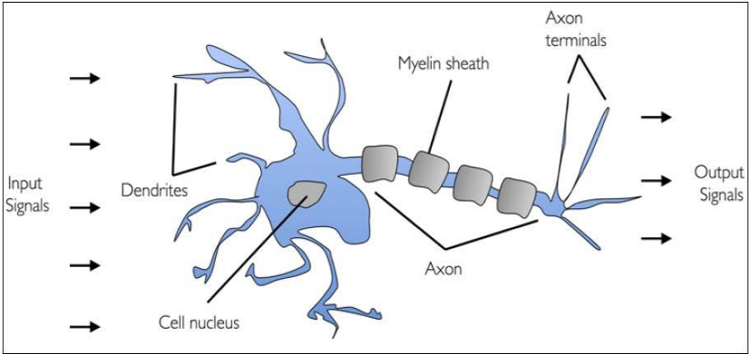
Biological Neuron

Slide 4
Artificial Neuron
An artificial neuron is a mathematical function based on a model of biological neurons, where each neuron takes inputs, weighs them separately, sums them up and passes this sum through a nonlinear function to produce output.

Slide 5
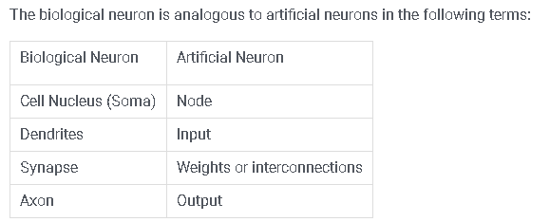
Biological Neuron vs. Artificial Neuron

Slide 6
Characteristics of Artificial Neuron
A neuron is a mathematical function modeled on the working of biological neurons
It is an elementary unit in an artificial neural network
One or more inputs are separately weighted
Inputs are summed and passed through a nonlinear function to produce output
Every neuron holds an internal state called activation signal
Each connection link carries information about the input signal
Every neuron is connected to another neuron via connection link

Slide 7
Perceptron
Perceptron is an artificial neuron(neural network unit).
A perceptron is a neural network unit that does certain computations to detect features or business intelligence in the input data.
Or single layer neural network is called perceptron

Slide 8
Perceptron
The perceptron consists of 4 parts.
Input values or One input layer
Weights and Bias
Net sum
Activation Function

Slide 9
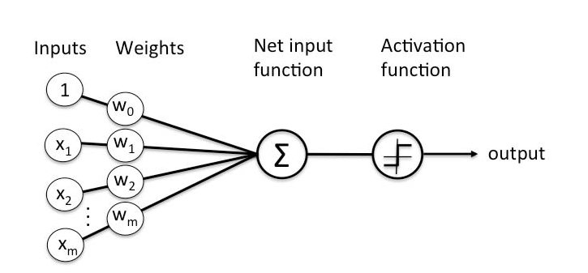
Perceptron

Slide 10
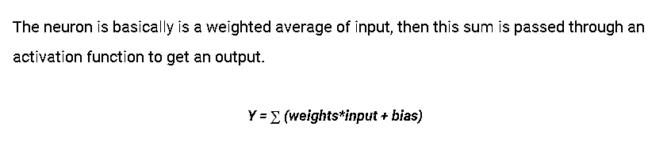

Slide 11


Slide 12
Working of perceptron
All the inputs x are multiplied with their weights w.
Add all the multiplied values and call them Weighted Sum.
Apply that weighted sum to the Activation Function.

Slide 13
Why do we need Weights and Bias?
Weights shows the strength of the particular node.
A bias value allows you to shift the activation function curve up or down.

Slide 14
Activation Function
Activation functions are mathematical equations that determine the output of a neural network.
The function is attached to each neuron in the network, and determines whether it should be activated (“fired”) or not, based on whether each neuron’s input is relevant for the model’s prediction.
They basically decide to deactivate neurons or activate them to get the desired output
Activation functions also help to normalize the output of each neuron to a range between 1 and 0 or between -1 and 1.

Slide 15
Types of activation functions
Threshold activation function(Bipolar Step Function with Threshold)
Unit step functions( Binary Step Function with Threshold)
Sigmoid activation function (logistic function)
Linear activation function
Piecewise (or, saturated) linear activation function
Gaussian activation function
Hyperbolic tangential activation function
Relu

Slide 16
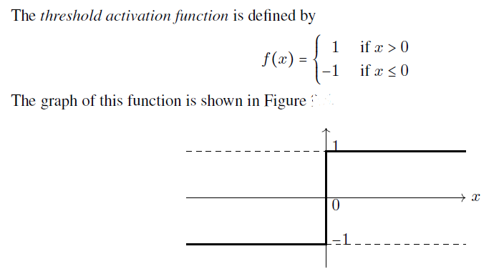
Bipolar Step Function with Threshold

Slide 17
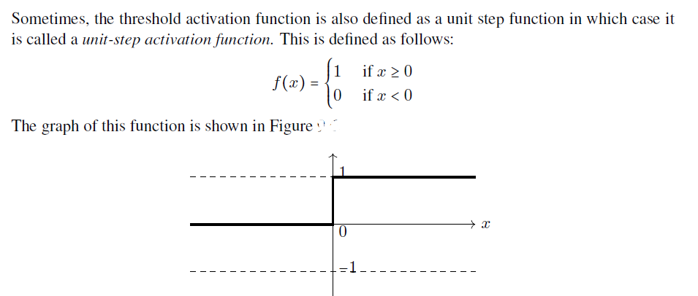
Binary Step Function with Threshold

Slide 18
Sigmoid activation function (logistic function)
Sigmoidal functions are of two types: -
(a) Binary sigmoid function
(b) Bipolar sigmoid function

Slide 19
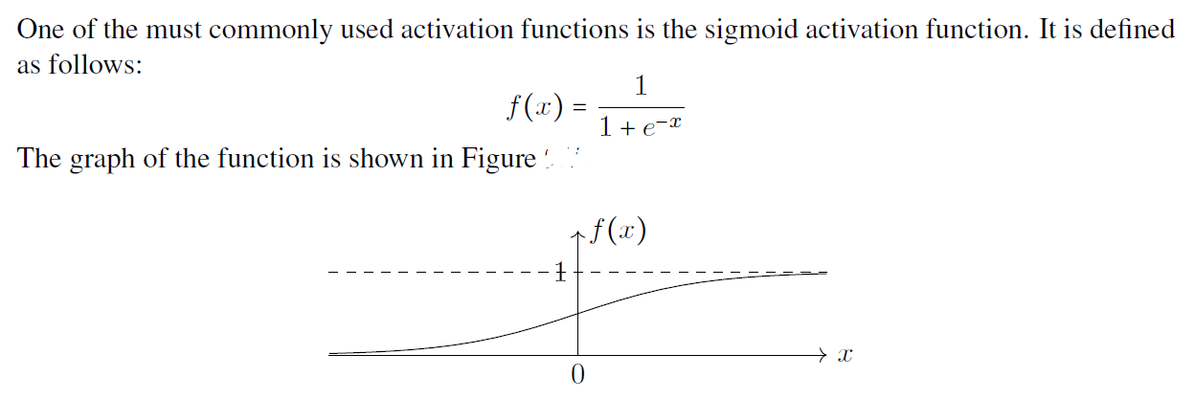
Binary sigmoid function

Slide 20
Bipolar Sigmoid
This function can be defined as,
f(x) = -1 + 2 / [1 + e^{-x}]

Slide 21
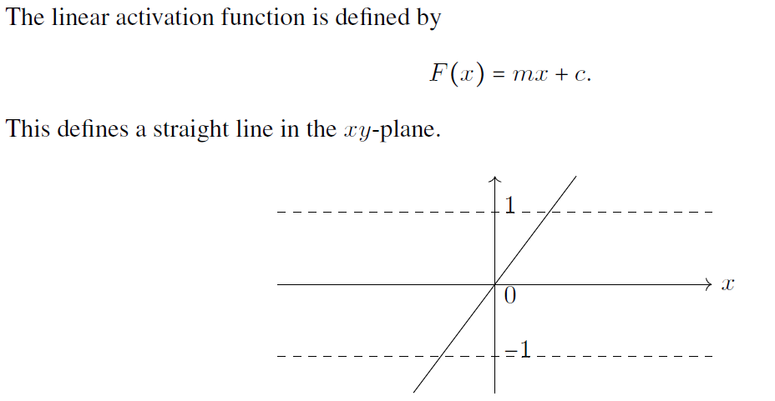
Linear activation function

Slide 22
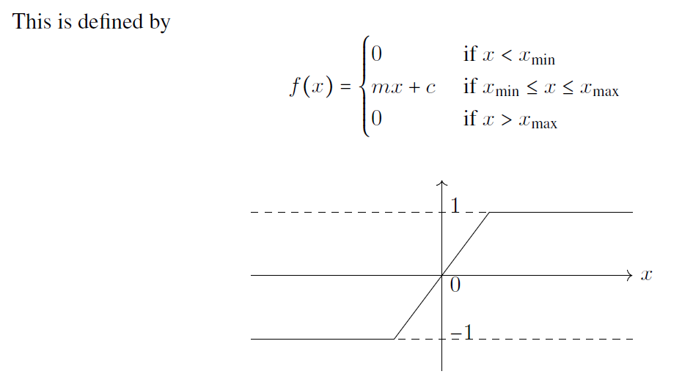
Piecewise (or, saturated) linear activation function

Slide 23
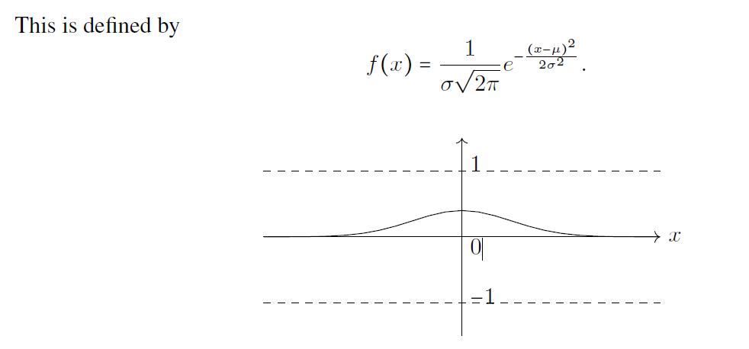
Gaussian activation function

Slide 24
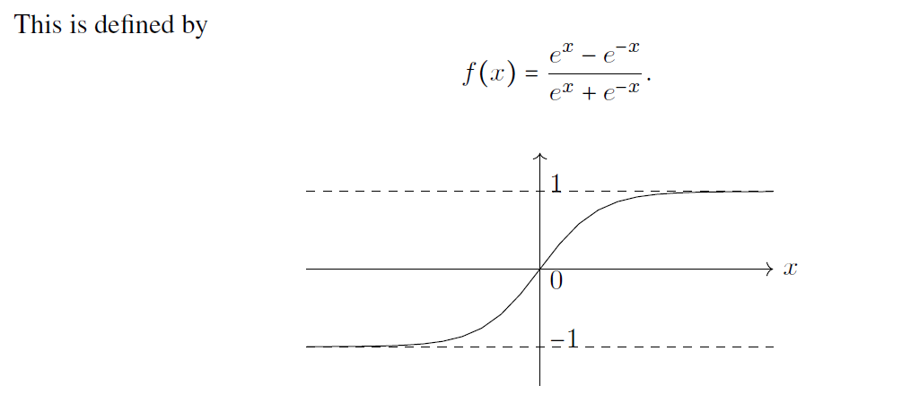
Hyperbolic tangential activation function

Slide 25
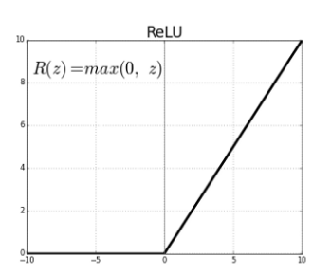
ReLU( Rectified Linear unit) Activation function
Rectified linear unit or ReLU is most widely used activation function right now which ranges from 0 to infinity.
All the negative values are converted into zero.
f(z) is zero when z is less than zero and f(z) is equal to z when z is above or equal to zero.

Slide 26
Artificial neural networks
An ANN is based on a collection of connected units called artificial neurons.
Each connection between artificial neurons has a weight attached to it that get adjusted as learning proceeds.
Artificial neurons may have a threshold such that only if the aggregate signal crosses that threshold the signal is sent.
Artificial neurons are organized in layers.
It helps you to build predictive models from large databases.
This model builds upon the human nervous system.
It helps you to conduct image understanding, human learning, computer speech, etc.

Slide 27
Artificial neural networks
An ANN can be defined and implemented in several different ways.
The way the following characteristics are defined determines a particular variant of an ANN.
The activation function
The network topology (or architecture)
The training algorithm

Slide 28
Artificial neural networks
The network topology (or architecture)
This describes the number of neurons in the model as well as the number of layers and manner in which they are connected.
The training algorithm
This algorithm specifies how connection weights are set in order to inhibit or excite neurons in proportion to the input signal.

Slide 29
Network topology
By “network topology” we mean the patterns and structures in the collection of interconnected nodes.
The power of a network is not only a function of the network size,
but also the way units are arranged.
Different forms of forms of network architecture can be differentiated by the following characteristics:
The number of layers
Whether information in the network is allowed to travel backward
The number of nodes within each layer of the network

Slide 30
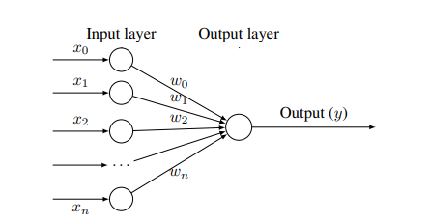
An ANN with only one layer

Slide 31
The number of layers
The artificial Neural network is typically organized in layers.
Layers are being made up of many interconnected ‘nodes’ which contain an ‘activation function’.
A neural network may contain the following 3 layers:
a. Input layer
b. Hidden Layer
c. Output layer

Slide 32
The number of layers
a. Input layer
The purpose of the input layer is to receive as input the values of the attributes for each observation.
Usually, the number of input nodes in an input layer is equal to the number of explanatory variables. (features)
b. Hidden Layer
A hidden node is a node that processes the signals from the input nodes (or other such nodes) prior to reaching the output nodes.
c. Output layer
The output nodes (there may be more than one) are those nodes which generate the final predicted values.

Slide 33
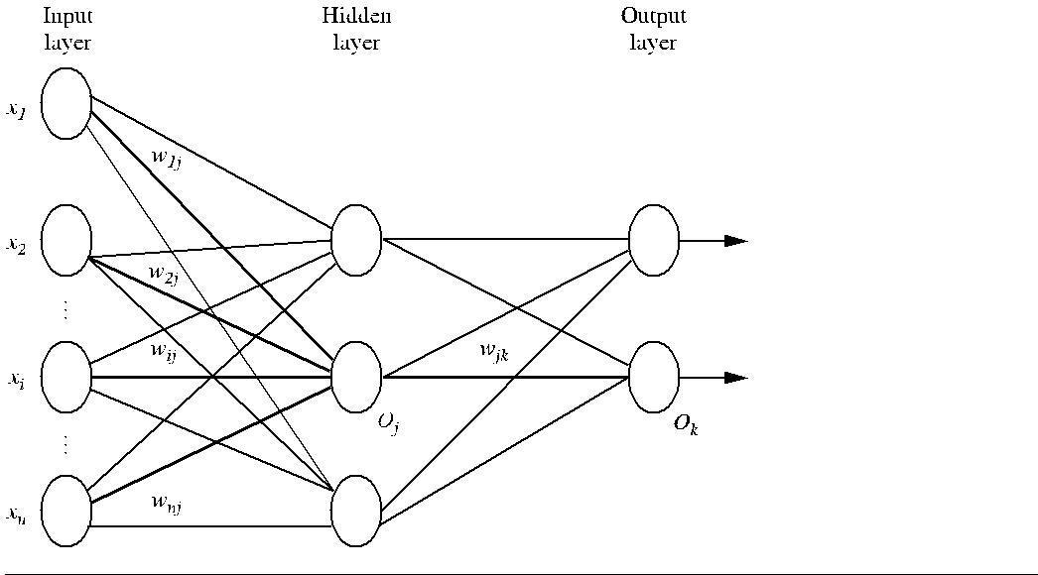
Artificial Neural Network

Slide 34
The direction of information travel
Networks in which the input signal is fed continuously in one direction from connection to connection until it reaches the output layer are called feedforward networks.
Networks which allows signals to travel in both directions using loops are called recurrent networks (or, feedback networks).
Multilayer feedforward network, sometimes called the Multilayer Perceptron (MLP), is the de facto standard ANN topology.

Slide 35
The number of nodes in each layer
The number of input nodes is predetermined by the number of features in the input data.
Similarly, the number of output nodes is predetermined by the number of outcomes to be modeled or the number of class levels in the outcome.
However, the number of hidden nodes is left to the user to decide prior to training the model.
There is no reliable rule to determine the number of neurons in the hidden layer.
The appropriate number depends on the number of input nodes, the amount of training data, the amount of noisy data, and the complexity of the learning task, among many other factors.

Slide 36
Learning a perceptron
By “learning a perceptron” we mean the process of assigning values to the weights and the threshold such that the perceptron produces correct output for each of the given training examples

Slide 37
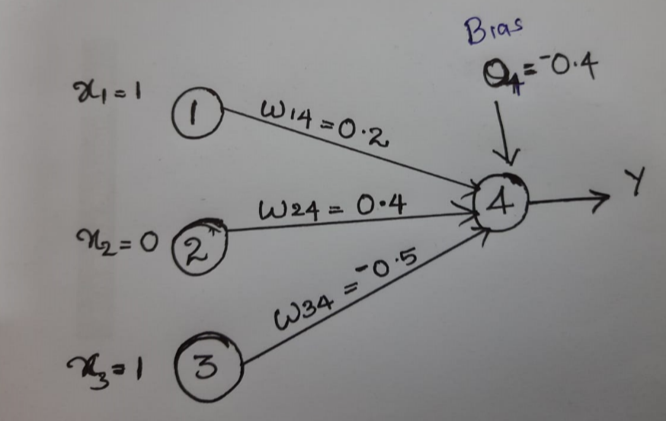
Calculate the output at node 4(Activation function is sigmoid )

Slide 38
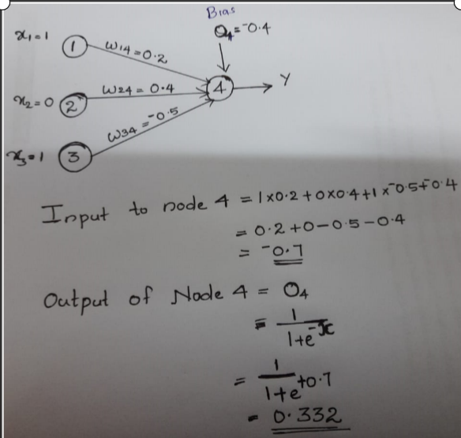

Slide 39
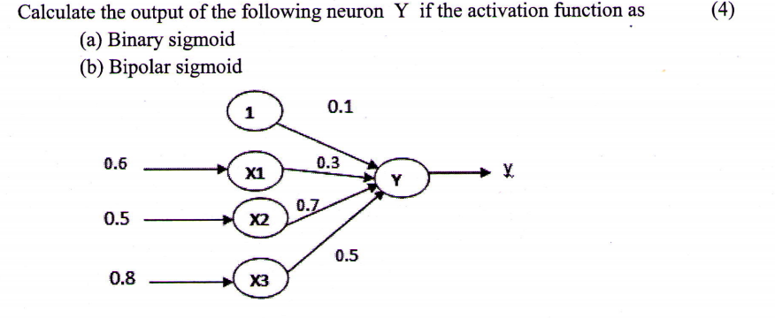
University question

Slide 40
Bias Neuron in a Neural Network
The bias neuron is a special neuron added to each layer in the neural network, which simply stores the value of 1.
This makes it possible to move or “translate” the activation function left or right on the graph.
Without a bias neuron, each neuron takes the input and multiplies it by a weight, with nothing else added to the equation.
So, for example, it is not possible to input a value of 0 and output 2.
In many cases, it is necessary to move the entire activation function to the left or right to generate the required output values—this is made possible by the bias.
Although neural networks can work without bias neurons, in reality, they are almost always added, and their weights are estimated as part of the overall model.

Slide 41
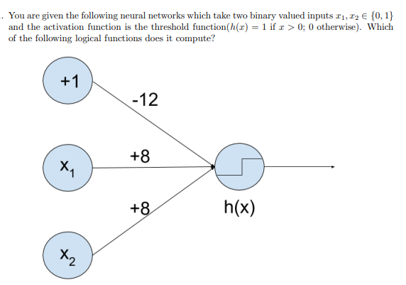
OR
AND
NAND

Slide 42
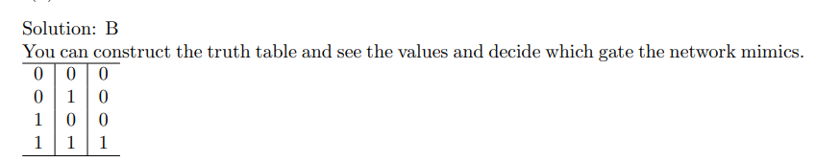

Slide 43
The neural network given bellow takes two binary valued inputs x1,x2 {0,1} and the activation function is the binary threshold function . Which of the logical functions does it compute?
+1
-1
+5
H(x)
x1
+5
x2

Slide 44
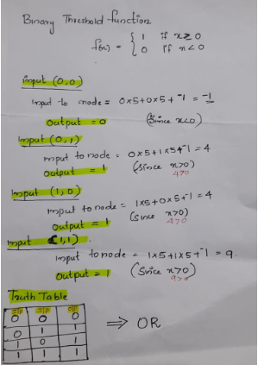
Answer

Slide 45
Training feed forward network by back propagation
There are many different kinds of neural networks and neural network algorithms.
The most popular neural network algorithm is backpropagation, which gained repute in the 1980s.

Slide 46
Back propagation algorithm
The backpropagation algorithm performs learning on a multilayer feed-forward neural network.
It iteratively learns a set of weights for prediction of the class label of tuples.
A multilayer feed-forward neural network consists of an input layer, one or more hidden layers, and an output layer.

Slide 48
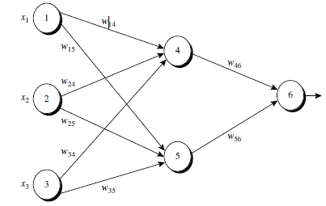

Slide 49
Each layer is made up of units.
The inputs to the network correspond to the attributes measured for each training tuple.
The inputs are fed simultaneously into the units mak-ing up the input layer.
These inputs pass through the input layer and are then weighted and fed simultaneously to a second layer of “neuronlike” units, known as a hidden layer.

Slide 50
The number of hidden layers is arbitrary, although in practice, usually only one is used.
The weighted outputs of the last hidden layer are input to units making up the output layer, which emits the network’s prediction for given tuples.
The units in the input layer are called input units.
The units in the hidden layers and output layer are sometimes referred to as neurodes, due to their symbolic biological basis, or as output units.

Slide 51
Perceptron Learning –(trial‐and‐error )
Continuous process of:
Trial:
Processing an input to produce an output (In terms of ANN: Compute the output function of a given input)
Evaluate:
Evaluating this output by comparing the actual output with the expected output.
Adjust:
Adjust the weights and bias

Slide 52
Backpropagation
Backpropagation learns by iteratively processing a data set of training tuples, comparing the network’s prediction for each tuple with the actual known target value.
The target value may be the known class label of the training tuple (for classification problems) or a continuous value (for prediction).
For each training tuple, the weights are modified so as to minimize the mean squared error between the network’s prediction and the actual target value.
These modifications are made in the “backwards” direction, that is, from the output layer, through each hidden layer down to the first hidden layer (hence the name backpropagation).. The algorithm is summarized in below.

Slide 53
Algorithm: Backpropagation.
The steps involved are expressed in terms of inputs, outputs, and errors. The steps are described below.
Neural network learning for classification or prediction, using the backpropagation algorithm.
Input:
D, a data set consisting of the training tuples and their associated target values;
l, the learning rate;
network, a multilayer feed-forward network.
Output: A trained neural network.

Slide 54
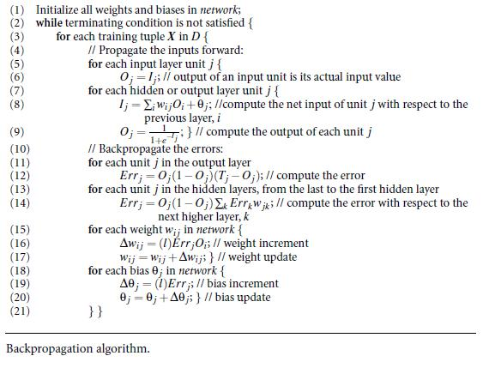

Slide 55
MAIN STEPS
Initialize the weights:
Propagate the inputs forward
Backpropagate the error
Terminating condition

Slide 56
MAIN STEPS
The weights in the network are initialized to small random numbers (e.g., ranging from -1.0 to 1.0, or -0.5 to 0.5).
Each unit has a bias associated with it, as explained below. The biases are similarly initialized to small random numbers.
Each training tuple, X, is processed by the following steps.

Slide 57
Propagate the inputs forward:
First, the training tuple is fed to the input layer of the network.
The inputs pass through the input units, unchanged.
That is, for an input unit, j, its output, O _{j}, is equal to its input value, I_{j}.
Next, the net input and output of each unit in the hidden and output layers are computed.
The net input to a unit in the hidden or output layers is computed as a linear combination of its inputs. Consider the figure below

Slide 58
Propagate the inputs forward:
Each such unit has a number of inputs to it that are, in fact, the outputs of the units connected to it in the previous layer.
Each connection has a weight.
Given a unit j in a hidden or output layer, the net input, I_{j}, to unit j is
I_{j=} ∑w_{i J}O_{i} + θ_{j};
where w_{i j} is the weight of the connection from unit i in the previous layer to unit j;
O_{i} is the output of unit i from the previous layer;
θ_{j} is the bias of the unit.

Slide 59
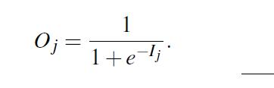
Propagate the inputs forward:
The bias acts as a threshold in that it serves to vary the activity of the unit.
Each unit in the hidden and output layers takes its net input and then applies an activation function
The function symbolizes the activation with unit j.
The logistic, or sigmoid, function is used.
Given the net input Ij ,then output of unit j is computed as
This function is also referred to as a squashing function, because it maps a large input domain onto the smaller range of 0 to 1

Slide 60

Backpropagate the error:
The error is propagated backward by updating the weights and biases to reflect the error of the network’s prediction.
For a unit j in the output layer, the error Err _{j} is computed by
where O _{j} is the actual output of unit j,
T_{j} is the known target value of the given training tuple.
To compute the error of a hidden layer unit j, the weighted sum of the errors of the units Connected to unit j in the next layer are considered.

Slide 61
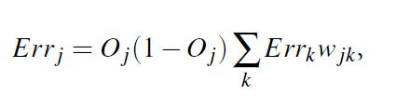
The error of a hidden layer unit j is
where w _{jk} is the weight of the connection from unit j to a unit k in the next higher layer
Err_{k} is the error of unit k.

Slide 62
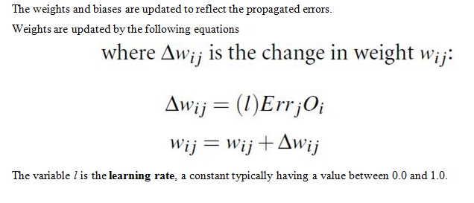

Slide 63
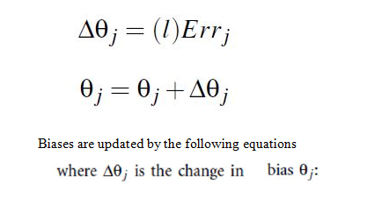
Bias updation

Slide 64
Note that here we are updating the weights and biases after the presentation of each tuple. This is referred to as case updating.
Alternatively, the weight and bias increments could be accumulated in variables, so that the weights and biases are updated after all of the tuples in the training set have been presented.
This latter strategy is called epoch updating, where one iteration through the training set is an epoch

Slide 65
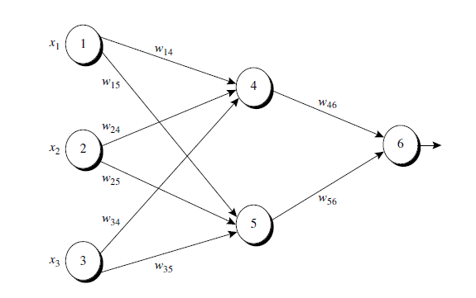
Example of a multilayer feed-forward neural network
Ө= -0.4
=0.2
=1
Ө= 0.1
= -0.3
= -0.3
= 0.4
=0
Ө= 0.2
= 0.1
= -0.2
= -0.5
= 0.2
=1
Learning rate ,l=0.9

Slide 66
Figure shows a multilayer feed-forward neural network.
Let the learning rate be 0.9.
The initial weight and bias values of the network are given in Table , along with the first training tuple, X =(1, 0, 1), with a class label of 1.

Slide 67
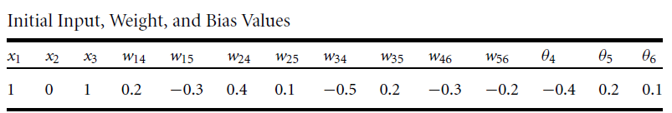
Example of a multilayer feed-forward neural network

Slide 68
Input and output at node 1,2 ,3(Input Layer)
Input
Output
I₁=1
I₂=0
I₃=1
O₁=1
O₂=0
O₃=1

Slide 69
Net input at node 4 (hidden node)
I₄= (1 *0.2)+(0*0.4)+(1* -0.5) + -0.4
=0.2+ 0 -0.5 -0.4
=-0.7

Slide 70
Output at node 4
O₄= 1/ 1+ e ^{0.7}
=0.332

Slide 71


Input and output at node 5
Net Input at node 5
output at node 5

Slide 72


Input and output at node 6
Net Input at node 6
output at node 6

Slide 73
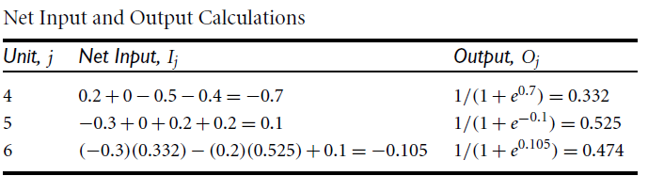
Example of a multilayer feed-forward neural network

Slide 74
O₄=0.332
O₅=0.525
O₆=0.474

Slide 75
Error at node 6(out put layer)
Err6=O₆(1-O₆)(T₆-O₆)
=0.474(1-0.474)(1-0.474)
= 0.1311
O₄=0.332
O₅=0.525
O₆=0.474

Slide 76
Error at node 5(hidden layer)
Err₅=O₅(1-O₅) Err ₆ w₅₆
=(0.525)(1-0.525)(0.1311) (-0.2)
=-0.0065
O₄=0.332
O₅=0.525
O₆=0.474
Err₆=0.1311

Slide 77
Error at node 4(hidden layer)
Err₄=O₄(1-O₄) Err ₆ w₄₆
=(0.332)(1-0.332)(0.1311) (-0.3)
=-0.0087
O₄=0.332
O₅=0.525
O₆=0.474
Err₆=0.1311
Err₅=-0.0065

Slide 78
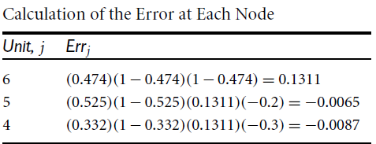

Slide 79


Weight update at W₄₆
W₄₆ =W₄₆ + (0.9 )Err ₆ O ₄
=-0.3 +(0.9)(0.1311) (0.332)
=-0.261
O₄=0.332
O₅=0.525
O₆=0.474
Err₆=0.1311
Err₅=-0.0065
Err₄=-0.0087

Slide 80
Weight update at W₅₆
W₅₆ =W₅₆ + (0.9 )Err ₆ O ₅
=-0.2 +(0.9)(0.1311) (0.525)
=-0.138
O₄=0.332
O₅=0.525
O₆=0.474
Err₆=0.1311
Err₅=-0.0065
Err₄=-0.0087

Slide 81
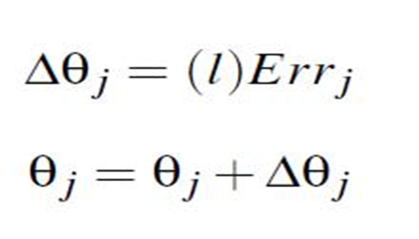
Bias update at node 6
Ө ₆ = Ө ₆ + (0.9) Err ₆
₌ 0.1+ (0.9) (01311)
=0.218

Slide 82
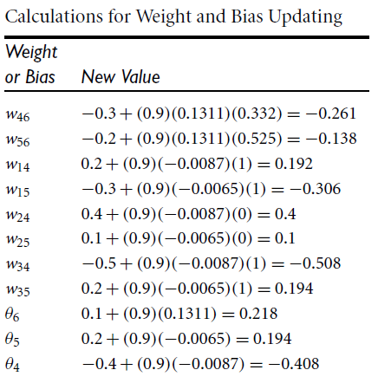

Slide 83
Terminating condition
Training stops when
All Wi j in the previous epoch were so small as to be below some specified threshold, or
2. The percentage of tuples misclassified in the previous epoch is below some threshold, or
3. A prespecified number of epochs has expired.
In practice, several hundreds of thousands of epochs may be required before the weights will converge.

Slide 84
